Slide 1
Car rental service – an example of Inversion of Control and Dependency Injection
Lars Bergqvist

Slide 2
Requirements
Make a service that can handle registrations of rentals and rental returns of vehicles
After a rental return, the service should be able to calculate the rental cost
The rental cost has a dedicated formula for each vehicle type
It should be easy to add new vehicle types to the system
It should be possible to change the storage type for the rental registrations to any persistence type (any type of database e.g.)

Slide 3
Design goals
The code should be easily extendable
The code should be testable
The code should be easy to understand
Apply Inversion of Control
No dependencies to concrete implementations
Dynamic loading of implementations
Can add new vehicle types without recompiling the service
Can change persistence layer without recompiling the service

Slide 4
Design
RentalService.Contract
Interfaces and entities for handling rental registrations
IRentalService
Handles calls for rental registrations and rental returns
Returns registered rentals
IVehicleTypesRepository
Returns all available vehicle types
RentalsRepository.Contract
Interfaces and entities for storing and updating rental registrations
VehicleTypes.Contract
IVehicleType
Implemented by the concrete vehicle types
Contains a Factory that loads all implementations of IVehicleType from available assemblies in the system dynamically

Slide 5
Registering a rental, RentVehicle
Client
RentVehicle(rentalRequest)
RentalService
AddNewRentalInfo
RentalsRepository
rentalReceipt

Slide 6
Registering a rental return, ReturnVehicle
Client
ReturnVehicle(returnRequest)
RentalService
RentalsRepository
UpdateRentalAsReturned
returnReceipt

Slide 7
Calculate the rental cost, GetPriceForRental
Client
RentalService
GetPriceForRental(rentalNumber, parameters)
RentalsRepository
GetRentalInfo
rentalCost
GetVehicleType object
VehicleTypes

Slide 8
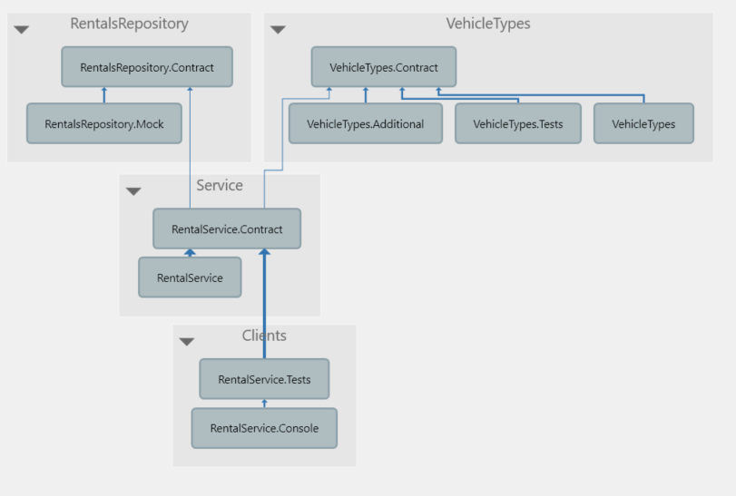
Assemblies and dependencies
Customers can get new vehicle types and/or new persistence layer without changing the exsiting syststem.
RentalService can be mocked.

Slide 9
The client code uses two interfaces when working with rentals
<<
Interface
>>
IVehicleTypesRepository
+
GetAvailabeVehicleTypes
<<
Interface
>>
Dependency
IRentalService
Client
Dependency
+
RentVehicle
+
ReturnVehicle
+
GetPriceForRental
+
GetAllRentals
+
GetRental

Slide 10
These interfaces are implemented by RentalService that in turn depends on two interfaces
<<
Interface
>>
IRentalsRepository
+
AddNewRental
+
UpdateRentalAsReturned
+
GetRental
+
GetAllRentals
<<
Interface
>>
IVehicleTypesFactory
<<
Interface
>>
+
GetVehicleType
IVehicleType
RentalsRepository
+
GetAllVehicleTypes
+
Name
+
GetRentalCost
Ninject
RentalService
+
RentalService
(
IVehicleTypesFactory
,
IRentalsRepository
)
<<
Interface
>>
Realization
IVehicleTypesRepository
Realization
+
GetAvailabeVehicleTypes
<<
Interface
>>
Dependency
IRentalService
Client
Dependency
+
RentVehicle
+
ReturnVehicle
+
GetPriceForRental
+
GetAllRentals
+
GetRental
Dependency

Slide 11
And these interfaces have implementations as described below
<<
Interface
>>
VehicleTypesFactory
IRentalsRepository
+
AddNewRental
Type
1
Type
2
+
UpdateRentalAsReturned
+
GetRental
+
GetAllRentals
Realization
Realization
<<
Interface
>>
Realization
IVehicleTypesFactory
<<
Interface
>>
+
GetVehicleType
IVehicleType
RentalsRepository
+
GetAllVehicleTypes
+
Name
+
GetRentalCost
RentalService
+
RentalService
(
IVehicleTypesFactory
,
IRentalsRepository
)
<<
Interface
>>
Realization
IVehicleTypesRepository
Realization
+
GetAvailabeVehicleTypes
<<
Interface
>>
Dependency
IRentalService
Client
Dependency
+
RentVehicle
+
ReturnVehicle
+
GetPriceForRental
+
GetAllRentals
+
GetRental
Dependency

Slide 12
The implementations are loaded dynamically with Ninject
Reflection
Reflection
To be able to bind several different implementations to IVehicleType in an easy way, a dedicated piece of reflection code is used.
<<
Interface
>>
VehicleTypesFactory
IRentalsRepository
+
AddNewRental
Type
1
Type
2
+
UpdateRentalAsReturned
+
GetRental
+
GetAllRentals
Realization
Realization
<<
Interface
>>
Realization
Creates
IVehicleTypesFactory
<<
Interface
>>
+
GetVehicleType
IVehicleType
RentalsRepository
+
GetAllVehicleTypes
+
Name
+
GetRentalCost
Creates
Ninject
RentalService
Creates
+
RentalService
(
IVehicleTypesFactory
,
IRentalsRepository
)
<<
Interface
>>
Realization
IVehicleTypesRepository
Realization
+
GetAvailabeVehicleTypes
<<
Interface
>>
Dependency
IRentalService
Client
Dependency
+
RentVehicle
+
ReturnVehicle
+
GetPriceForRental
+
GetAllRentals
+
GetRental
Dependency

Slide 13
Technologies and frameworks
Visual Studio 2013
.NET 4.5, C#
NUnit for testing
Ninject for dependency injection

Slide 14
Discussion
If this was a real project/product, this design would probable be BDUF if implemented in this way from the start
A better approach would be to start with the core values like programming against interfaces + using constructor injection and wait with refactoring into separate assemblies + dynamic assembly loading until the system grows

